Slide 1

Health and Wellness Retreat
By Ayush Naturopathy Foundation

Slide 2

What is Ayush Naturopathy Foundation
ANF stands for Ayush Naturopathy Foundation registered under the Ministry of Cooperate Affairs is committed to give good health and employment to everyone. ANF was established in August 2021 and till date we have successfully treated a large number of patients suffering from different ailments. We have highly experienced Doctors and Therapist team who all are well versed in their field. We believe in the healing power of nature so our all treatments are natural without any drugs or surgery. Our Alternative medicinal therapies like Naturopathy, Ayurveda, Acupressure / Acupuncture, Cupping, Panch Karma, Chiropractic etc.
Our Director Sh. Ajay Tiwari and Mrs. Rekha Tiwari founded Ayush Naturopathy in Augus 2021 since then we are continuously working at our NGO motto i.e. सबको स्वास्थ्य, सबको रोजगार ! We not only treat people but also educate them so that they can become their own doctors and get relief from their day to day common ailments. Our dedicated team of founder members also working hard to achieve the goals. We are presently working in more than 8 states successfully.

Slide 3
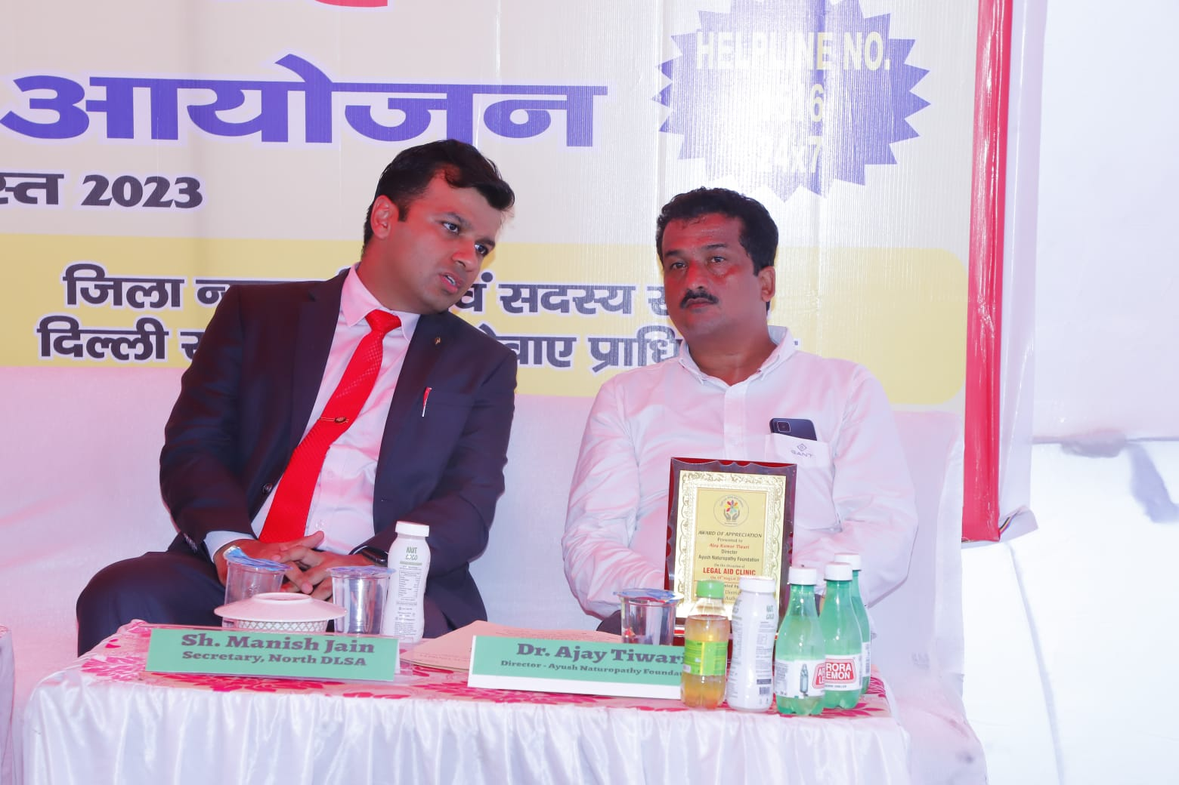
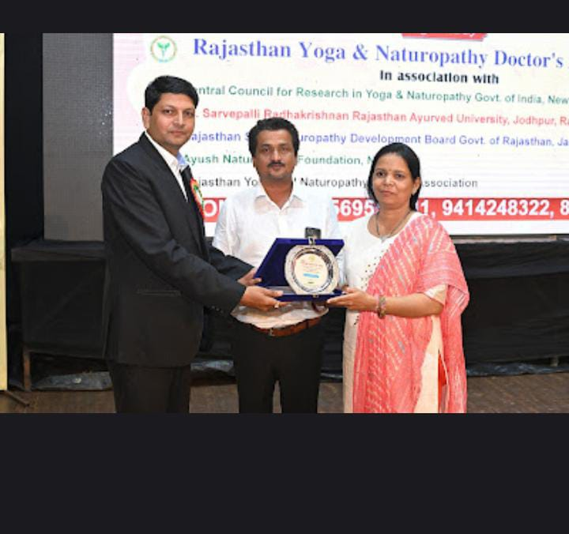
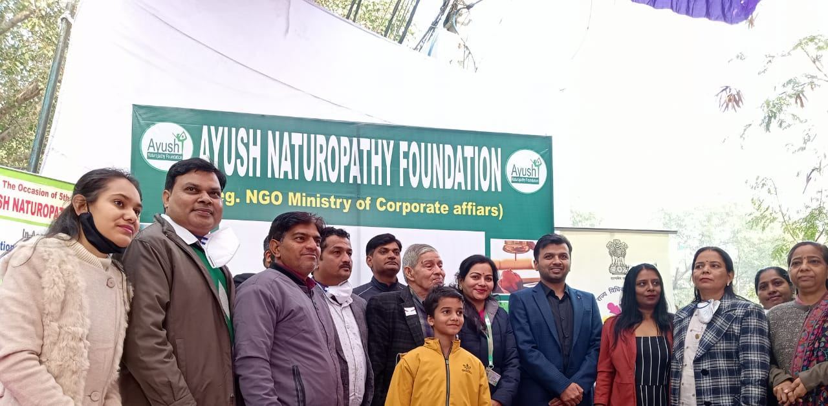
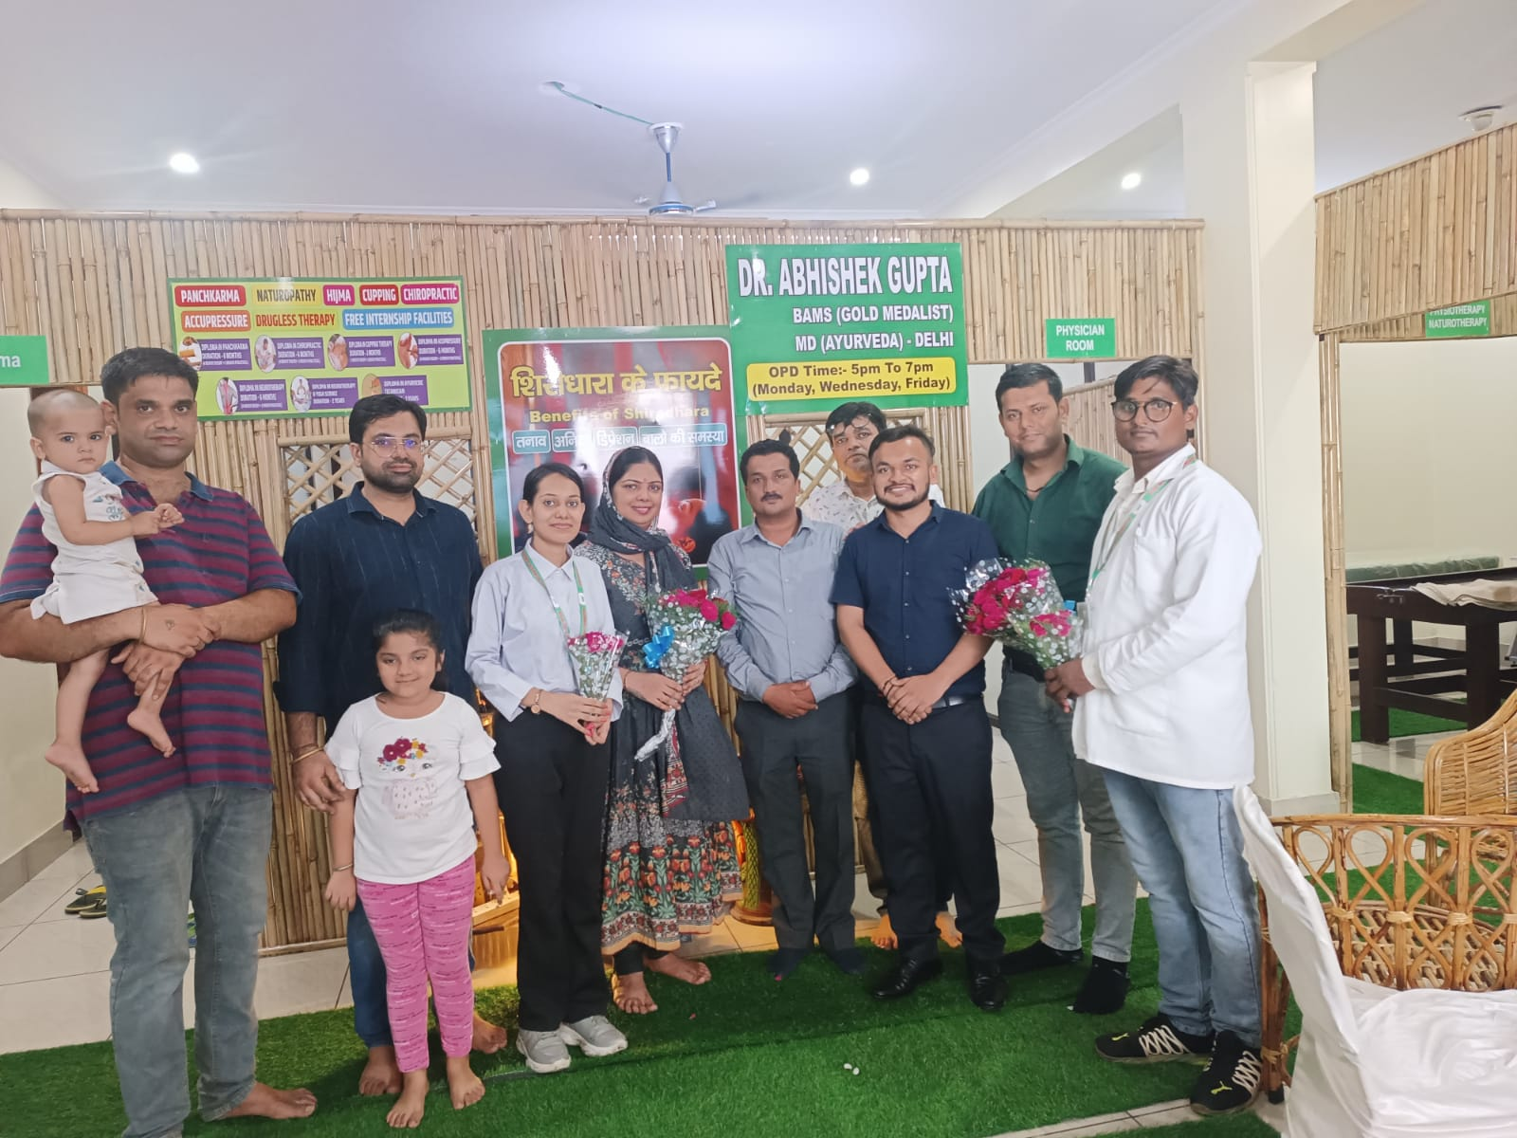
ANF Journey Through Pictures !

Slide 4
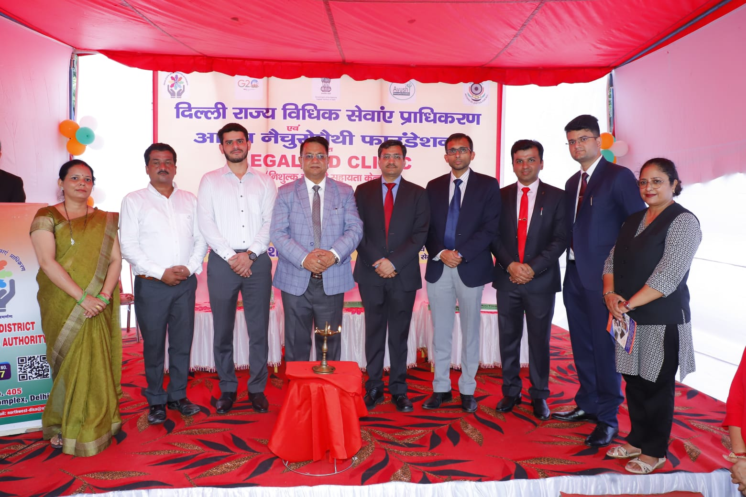
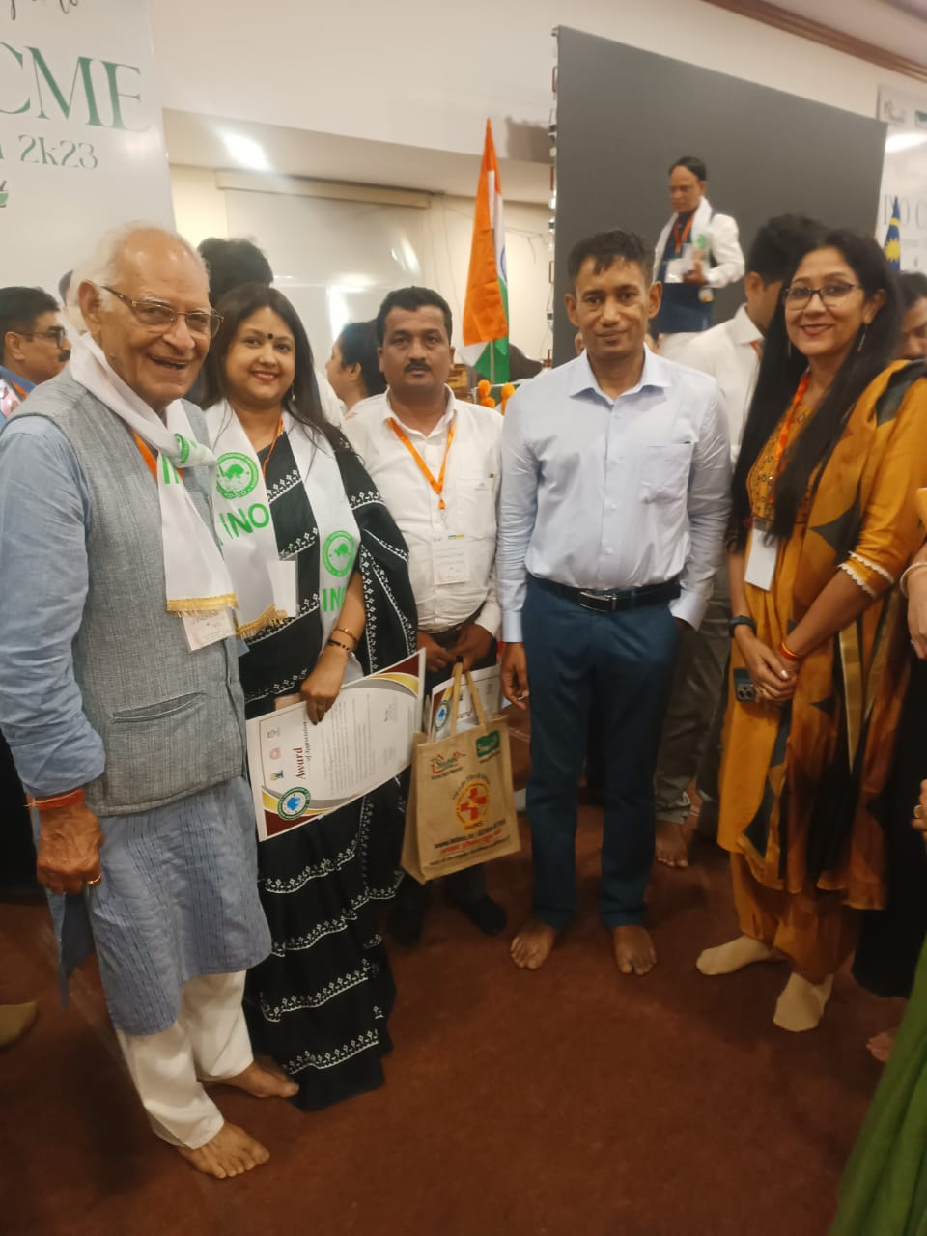
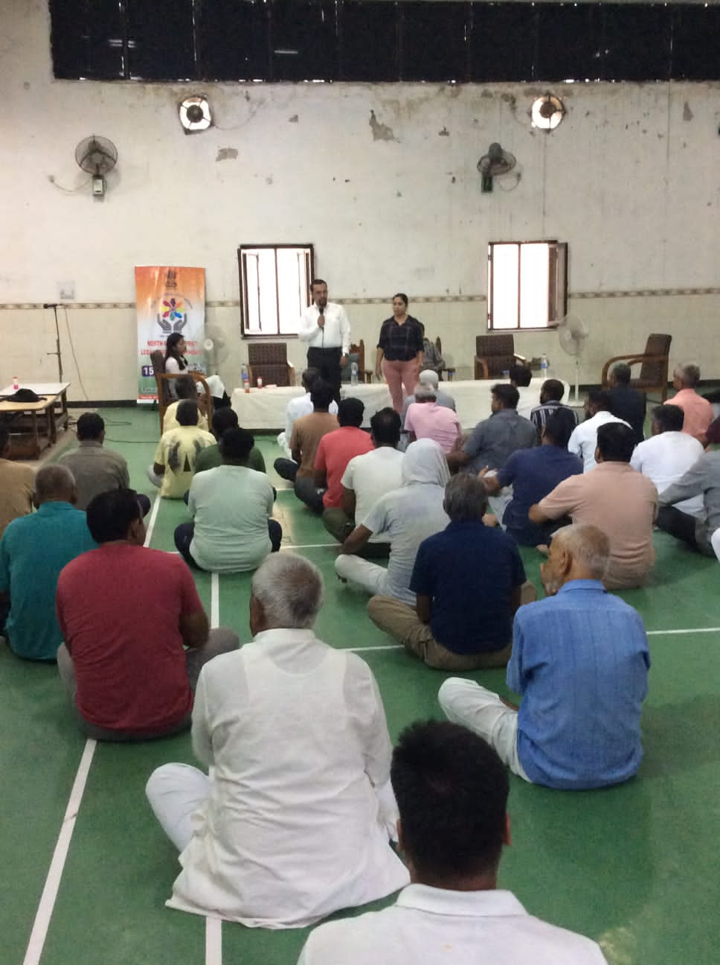
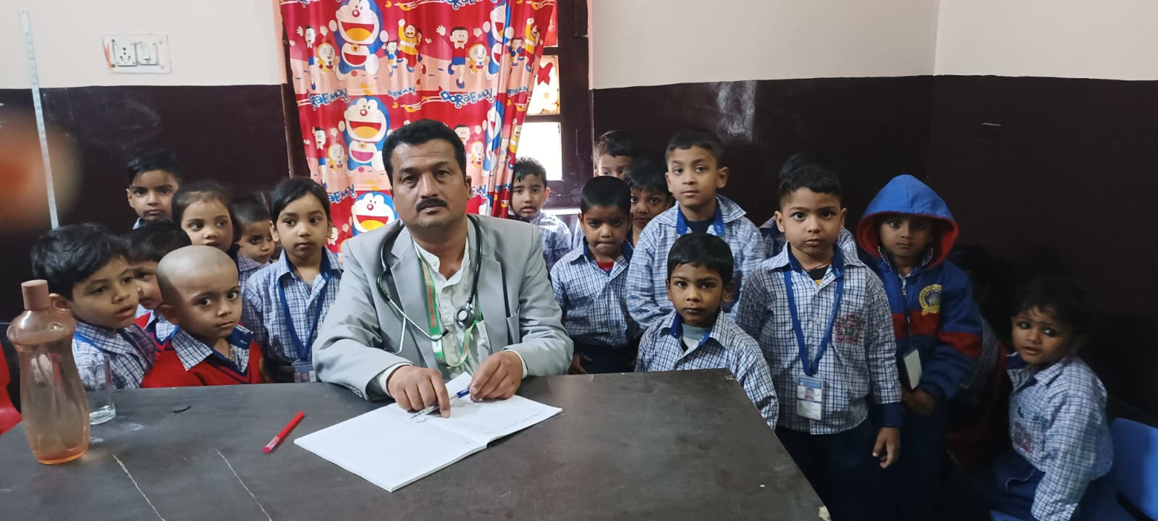
ANF Journey Through Pictures !

Slide 5
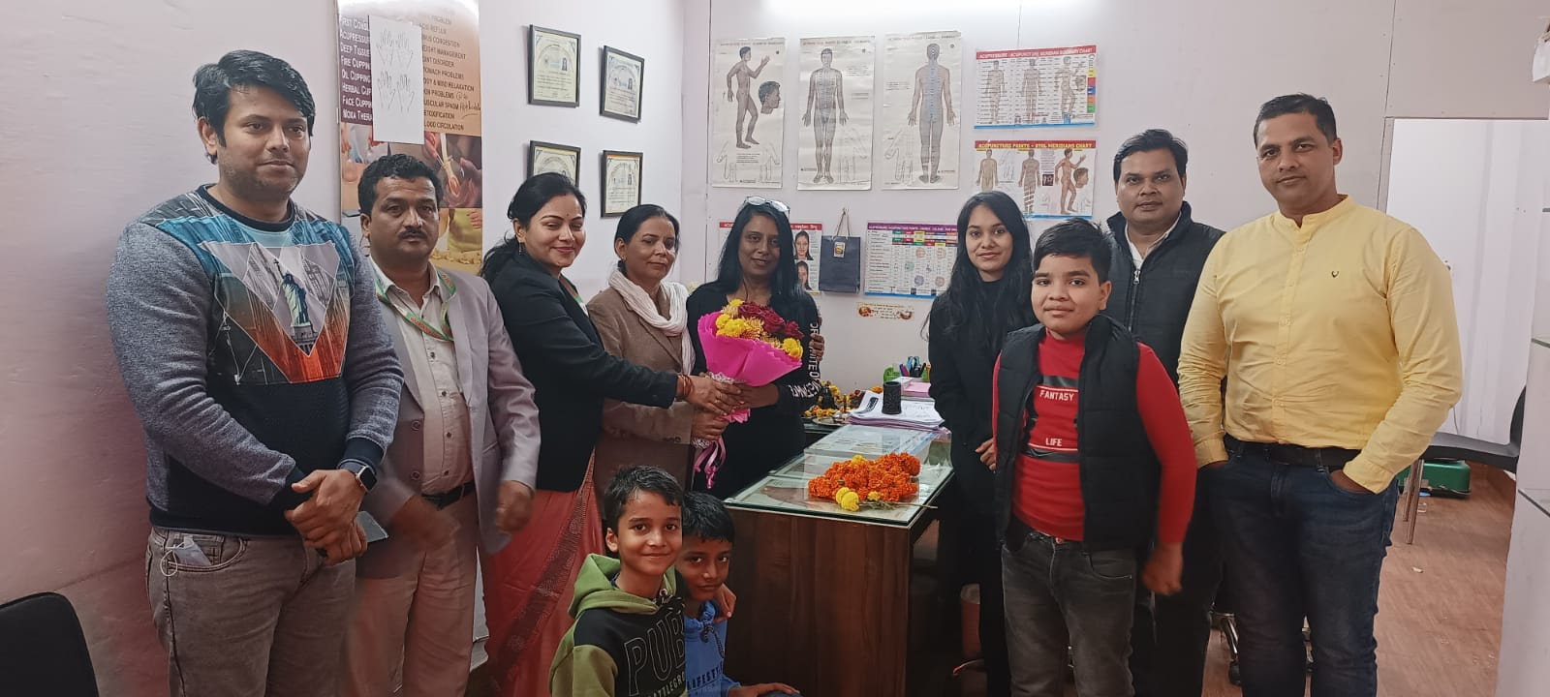
Ayush Naturopathy Foundation Team Members
We have a dedicated team of doctors and therapist who all are expertise in their fields. Our administrative and members team always ready to volunteer and actively take part in health retreat programs and camps.
Our Asministritative team is as follows-
Sh. Ajay Tiwari – Director of ANF
Mrs. Rekha Tiwari – Director of ANF
Dr. Jaidev Banerjee
Dr. Subhash Dayal
Dr. Pooja Bhushan
Sh. Vijay Arya
Sh. Ishwar Singh Shekawat
Sh. Pawan Bishnoi
We have a hardworking team of therapists and administration who successfully giving their 100% in the smooth running of the Dispensary. Our core committee team members and volunteers also working hard to achieve the foundation goals.

Slide 6
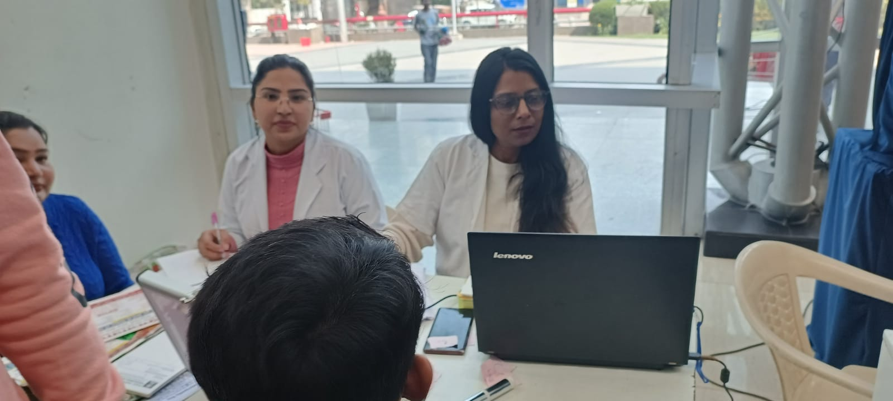
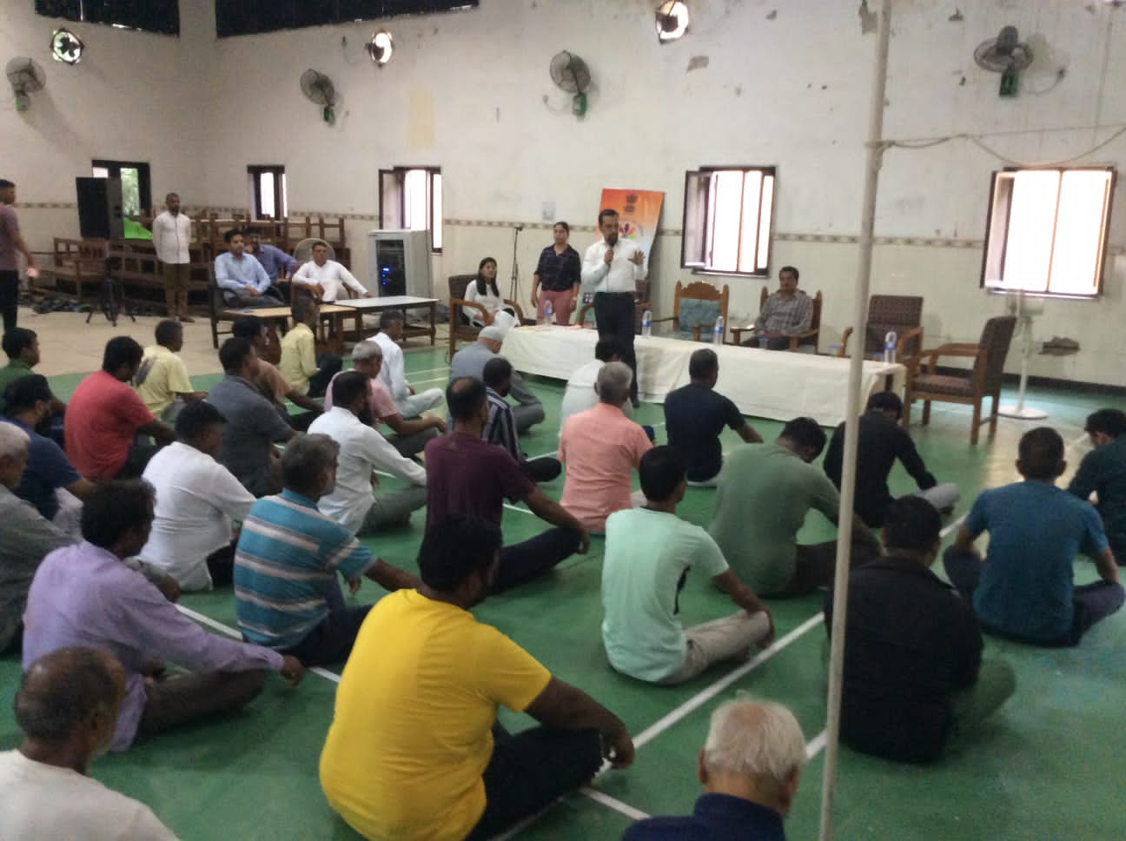
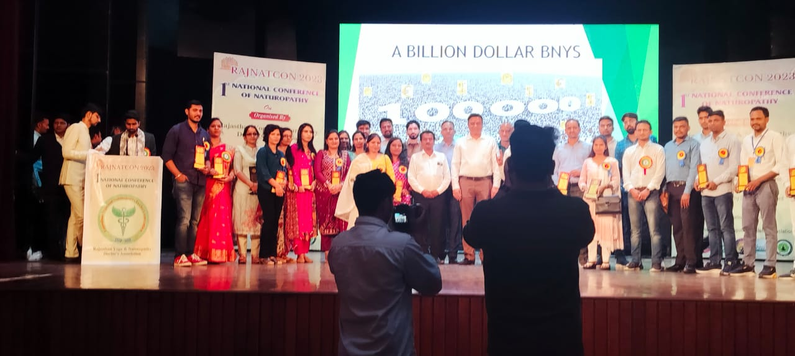
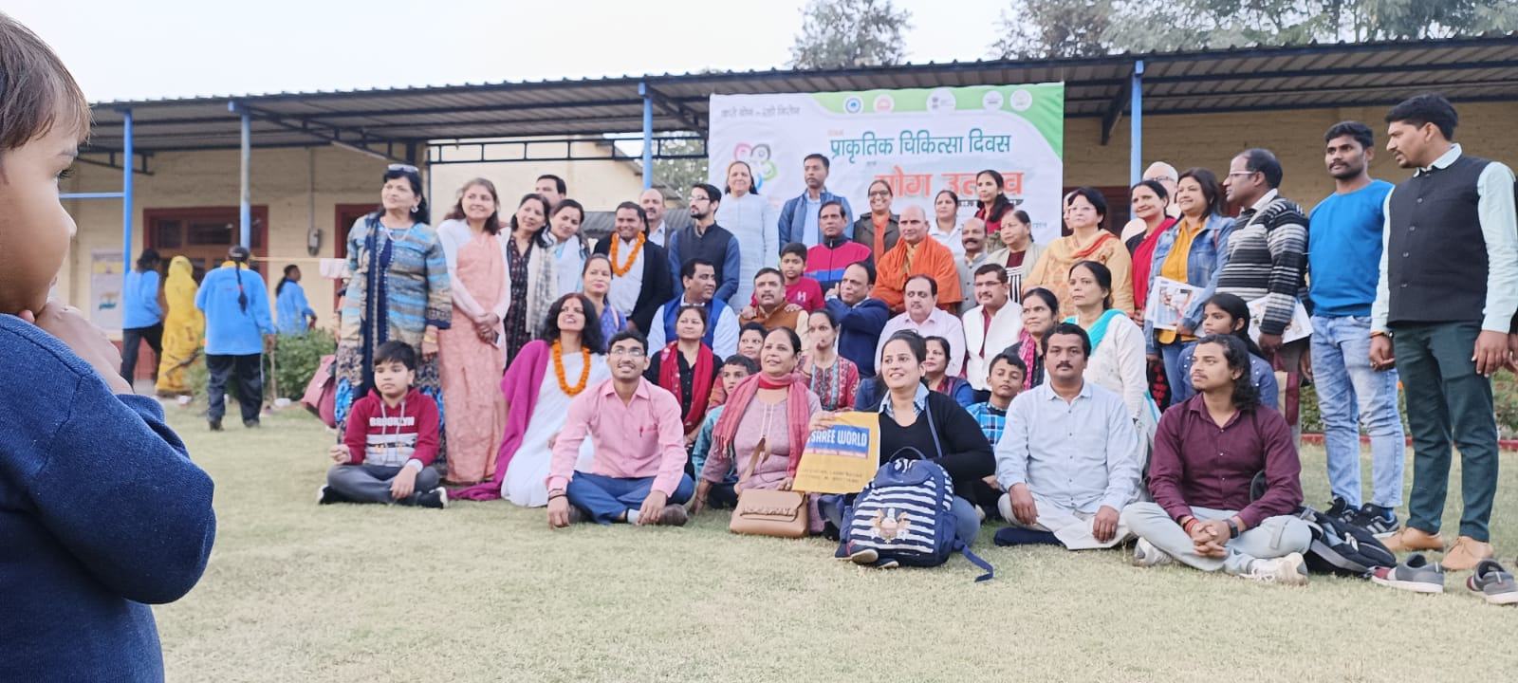
ANF Journey Through Pictures !

Slide 7
Ayush Naturopathy Foundation Achievements
ANF have India’s first Naturopathy charitable dispensary established on 15 July 2022 where we provide extensive Naturopathy treatments under one roof at very nominal charges. We are proud to say that we treat more than 20,000 patients successfully till date. The treatments provided at our dispensary are much more affordable than any other private or government hospital. Our only motto is to treat people and make them aware towards these kind of therapies which are lost somewhere in these days.
ANF successfully organized more than 100 health camps all over Delhi since November 2021 to till date. In those camps we provide free health checkups, free treatments and above all create awareness which helps everyone to understand the power of Naturopathy a holistic approach to wellness. ANF also started a Legal Aid clinic with the association of DSLSA (Delhi State Legal Services Authority) to provide free legal help to the needy ones.
ANF was also the guest of honor at 1st National Naturopathy Conference in Rajasthan On " Scientific Approach in Naturopathy" organized by the Rajasthan yoga and naturopathy doctor's association, Rajasthan India on 02 October 2023 in collaboration with Dr. S. R. Rajasthan Ayurveda University Karwad, Nagpur Road, Jodhpur, Central council for research in yoga and naturopathy (CCRYN), Rajasthan naturopathy development board GOR.

Slide 8
Ayush Naturopathy Foundation Achievements
ANF has also started a Think Tank where a group of experts brought together to provide advice, suggestions and ideas on specific social, political and economic problems or issues. Des deepak verma (secretary general) parliament. D. K juneja (Director RAINASABHA) are the part of our Think Tank. The work of all think tanks includes conducting scholarly research, creating a space for debate, generating ideas, monitoring public policy and providing intellectual resources to the public. We have successfully tie up with many top officials who can enlightened us with their presence. These officials can work with us on salary or incentive basis even after their retirements.
At ANF we not only provide health treatments and solutions. We also provide the employment by educating the people especially the younger generation through out certificate/Diploma and Master Diploma courses at very affordable charges with free internships at our dispensary and centers all over India. Our courses are approved and certified by government.

Slide 9

What do we mean by Health ?
Health and well being includes Physical, Mental, Social and Spiritual Health. A healthy person must have all the balances. Wellness is an active process through which people become aware of, and make choices toward, a more successful existence.
Physical health can be defined as the normal
functioning of the body it's about how your body
grows, feels and moves, how you care for it,
and what you put into it.
Mental health is a state of mental well-being
that enables people to cope with the stresses of
life, realize their abilities, learn well and work
well, and contribute to their community.
Social health is a term that refers to the ways
in which people create healthy and positive interpersonal relationships with one another.
Spiritual health creates a balance between physical, psychological and social aspects of human life.
With the help of Naturopathy and Yoga Sciences we can maintain and lead to a healthy life.

Slide 10
How important is it within @ Workplace?
It’s good to know the benefits of good health at workplace, so we’ve listed some reasons why health is important.
It is morally right to ensure your employees are healthy at the end of every working day.
You can reduce absences, ensuring that your workplace is more efficient and productive
Research shows that workers are more productive in workplaces that are committed to health and safety.
Reducing down-time caused by illness and accidents means less disruption – and saves your business money.
A good health and safety record is a source of competitive advantage.
Good health at work secures long-term benefits for you, your business and the wider community.

Slide 11
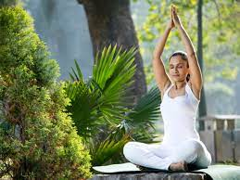
What to do now ?????????????
Now you know about the benefits of good health and wellbeing at workplace. So who can help to build resilience and positive thinking? Whose responsibility is to ensure an employee’s physical and mental health?
Make a Choice
Treatment ?
Or
Wellness ?

Slide 12

Here is the Answer
Ayush Naturopathy Foundation has designed a wellness retreat program to heal and rediscover yourself in a holistic way through Naturopathy and yoga. We have a team of experts, doctors, nutritionists, yoga instructors, and therapists who create retreat plans to address the wellness needs of your employees and coworkers. The underlying principles of naturopathy are the importance of a healthy diet, clean fresh water, sunlight, exercise and stress management.
Our variety of natural treatments promise to tackle health issues like cholesterol, obesity, skin problems, arthritis, and addictions. As well as our meditation process will help to heal you from inside.
Our 3 days wellness plan will rejuvenate you and kick start a more healthy lifestyle.

Slide 13
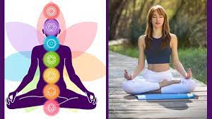
ANF Plan of Wellness Retreat Day 1
Checked in Wellness Destination
Welcome Drink on arrival
Time to refresh yourself followed by Satwik Diet
Customized Consultation by our professional
Rest and enjoy delicious Satwik food
Customized Therapies/ Mental Detoxification
Know more about Naturopathy
Satwik Dinner
Enjoy good and peaceful sleep

Slide 14

ANF Plan of Wellness Retreat Day 2
Wakeup call (Early to bed early to rise make a person healthy wealthy and wise)
Yoga and pranayama
Enjoy Delicious Breakfast
Customized Therapies/ Mental Detoxification
Satwik Lunch
Local Sightseeing
Delicious and healthy Dinner
Enjoy good and peaceful sleep

Slide 15
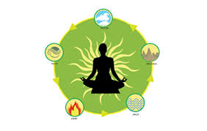
ANF Plan of Wellness Retreat Day 3
Wakeup call (Early to bed early to rise make a person healthy wealthy and wise)
Yoga and pranayama
Enjoy Delicious Breakfast
Customized Therapies/ Mental Detoxification
Satwik Lunch
Back to home
Our wellness retreat plan will make you fully rejuvenate and prepare you well for the upcoming challenges at work front. We ensure you that you will never forget these 3 days and get benefitted in every possible way.

